Slide 1



Workshop: Authoring OpsMgr Agent Tasks using Visual Studio Authoring Extension
Tao Yang
tao.yang@tyconsulting.com.au
http://www.tyconsulting.com.au
http://blog.tyang.org
April, 2016

Slide 2


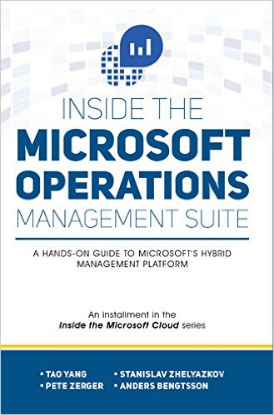
About Tao Yang
Independent Consultant – TY Consulting Pty Ltd
MVP – Cloud and Datacenter Management
System Center and OMS
SCOM Management Pack Developer
Co-Author of the Inside Microsoft Operations Management Suite book

Slide 3
Agenda
Introduction
Workshop
Q&A

Slide 4
Introduction
Goals:
Creating a Sealed MP using VSAE that contains
An agent task that invokes Systeminfo using PowerShell using VSAE Templates (No XML editing involved!)
More Advanced tasks that involves creating custom Write Action Modules (your ‘homework’ after this workshop)

Slide 5
Pre-Requisites
Download the Sample VSAE project and the workshop guide at: http://tiny.cc/u0xsay
Complete Section 2 Setting up Authoring Computer before this workshop.

Slide 6
Workshop

Slide 7
Additional Material
MP Authoring MVA Course: https://mva.microsoft.com/en-US/training-courses/system-center-2012-r2-operations-manager-management-pack-8829

Slide 8
Q&A

